Slide 1
Bi-LSTM
BY HAMAD

Slide 2
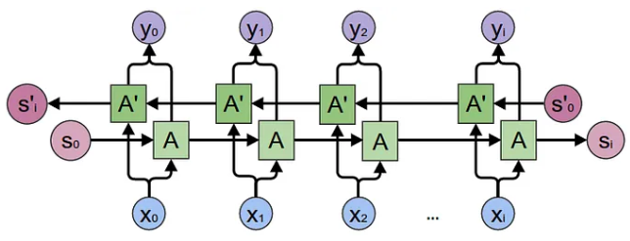

Slide 3
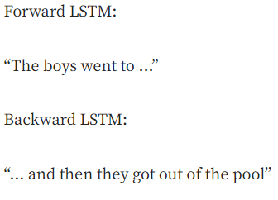
Bi-LSTM:

Slide 4

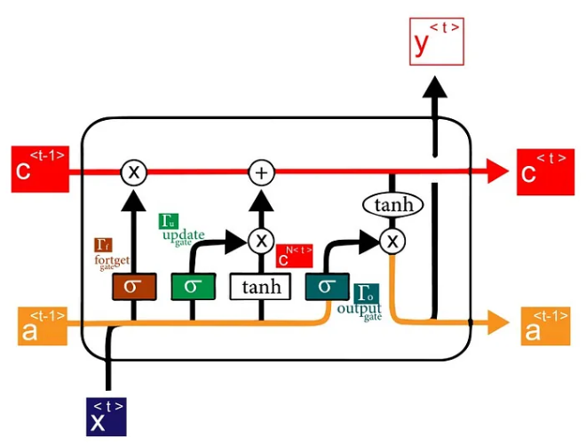

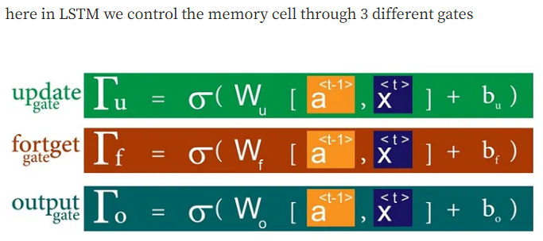

Vanilla LSTM Model:

Slide 5
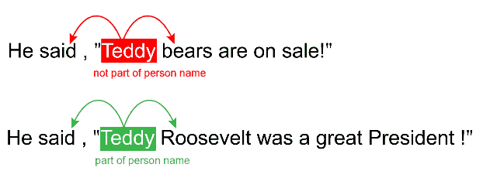

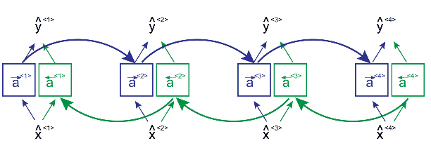
Reference: https://medium.com/@raghavaggarwal0089/bi-lstm-bc3d68da8bd0

